Slide 1


Prompt Engineering
Prompt Engineering is essentially the art and science of communicating effectively with AI models by carefully crafting input prompts to see their full potential across tasks.

Slide 2

Prompt Engineering Techniques
Zero-shot prompting for direct AI responses
Few-shot prompting utilizes limited examples
Chain-of-Thought guides AI reasoning process
Instruction tuning improves model adherence
Context framing sets relevant AI understanding
Toolformer-style helps AI use tools

Slide 3

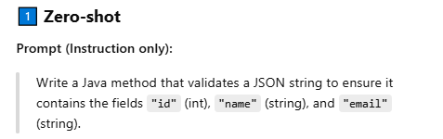
Zero-shot Prompting Explained
Directly ask AI without prior examples
Relies on AI's inherent understanding
AI generates relevant responses effectively

Slide 4

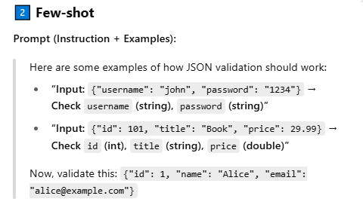
Few-shot Prompting Explained
Provide AI models with illustrative examples
Guide the model toward desired output
Improve model understanding and performance
Crucial for specific formatting or style

Slide 5
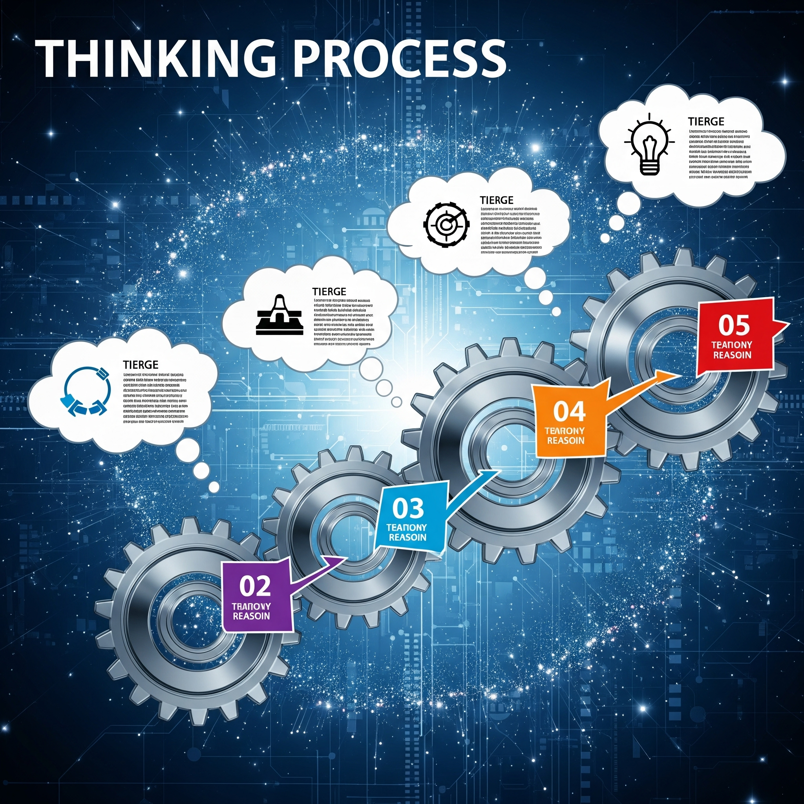
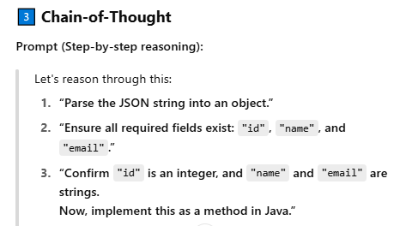
Chain-of-Thought Prompting
Model reasons step-by-step for complex tasks
Explaining thought process leads to accurate conclusions
Encourages logical problem-solving in AI models

Slide 6
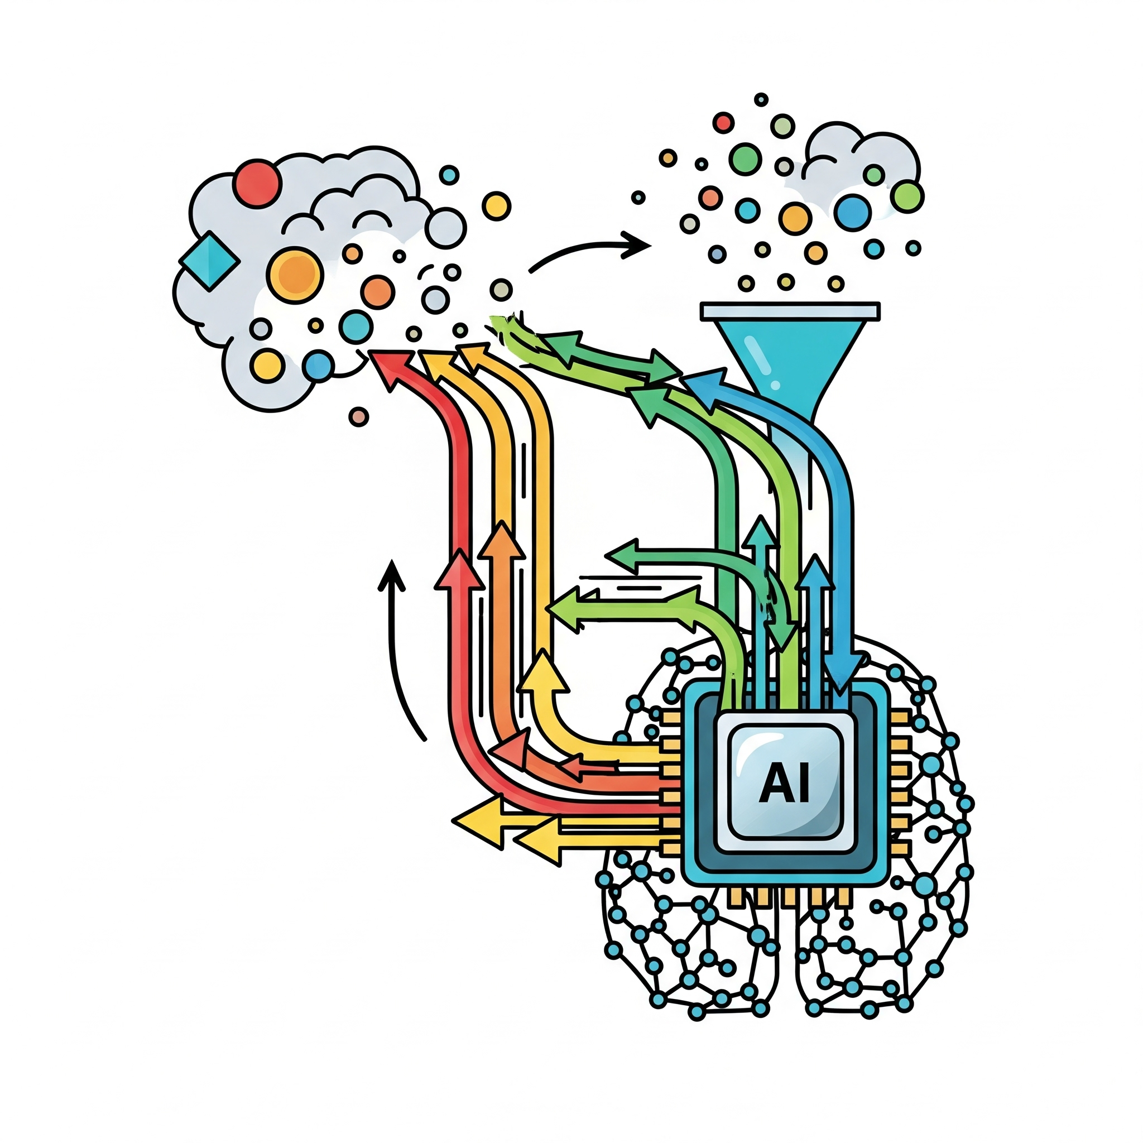
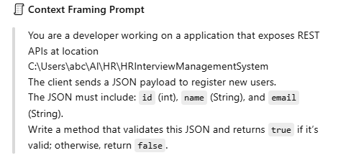
Context Framing Prompts
Adding context or constraints to a prompt
Narrows the scope of the AI model
Guides the model to specific knowledge
Reduces irrelevant or off-topic AI outputs

Slide 7

Prompt Engineering Challenges
Models are highly sensitive to wording
Minor changes alter outputs significantly
AI can hallucinate or produce biased content
Optimal prompts need much trial-and-error

